Slide 1
A POEM
In all chaotic beauty lies a wounded work of art.
Beautiful but torn, wreaking havoc on my heart.
Camouflaged by insecurities, blinded by it all.
I love the way you sit there and barely notice me at all

Slide 2

"A little madness in the Spring Is wholesome even for the King.“ Emily Dickenson

Slide 3
Spring is nature's way of saying, "Let's party!“ Robin Williams

Slide 4
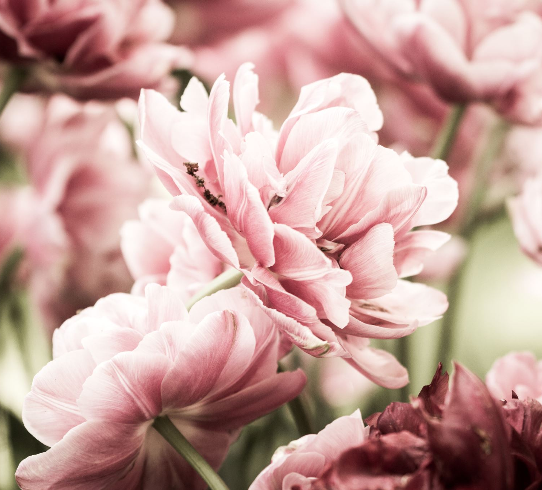
Crocus
Tulips
Daffodils

